Slide 1
BCSE209L Machine Learning
K-nearest neighbour (KNN) Algorithm for Regression
Dr. R. Jothi

Slide 2
KNN
Non-parametric model
Instance based or lazy learner
Used for both Classification and Regression tasks

Slide 3
1-Nearest Neighbor

Slide 4
3-Nearest Neighbor

Slide 5
K-NN Regression
KNN regression is a non-parametric method that, in an intuitive manner, approximates the association between independent variables and the continuous outcome by averaging the observations in the same neighbourhood.

Slide 6
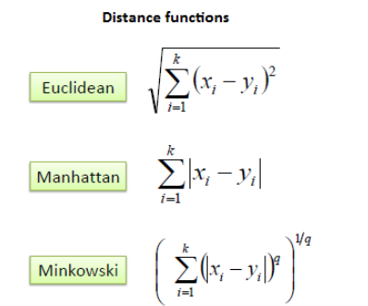

Slide 7
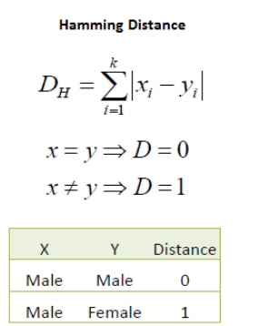

Slide 8
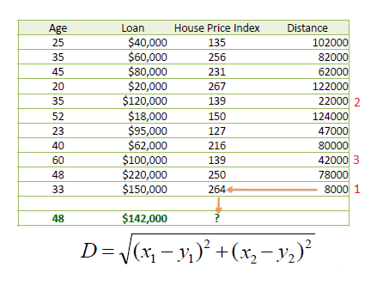
Example
We can now use the training set to classify an unknown case (Age=33 and Loan=$150,000) using Euclidean distance.
If K=1 then the nearest neighbor is the last case in the training set with HPI=264.
D = Sqrt[(48-33)^2 + (142000-150000)^2] = 8000.01 >> HPI = 264

Slide 9
Example
Consider the following data concerning House Price Index or HPI. Age and Loan are two numerical variables (predictors) and HPI is the numerical target.

Slide 10
Example
By having K=3, the prediction for HPI is equal to the average of HPI for the top three neighbors.
HPI = (264+139+139)/3 = 180.7

